Slide 1

Machine Learning Intermediate Project Submission
By
HARSHARAN SINGH KOHLI

Slide 2
AGENDA
INTRODUCTION
ABOUT DATASET
EXPLORATORY DATA ANALYSIS
METHODOLOGY & SALES PREDICTION
CONCLUSION

Slide 3
Project Introduction
Forecasting 3 Months of Sales
Given 5 years of daily sales data,the task is to forecast the next 3 months of sales.

Slide 4
ABOUT DATASET
Dataset Origin : Github Projects-Store Item Demand Forecast
Stores Sales data : 1st Jan 2013 to 31st Dec 2017
Number of stores :10
Number of Items: 50
Data has information columns on Date, Store, Item and Sales

Slide 5
Exploratory Data Analysis

Slide 6
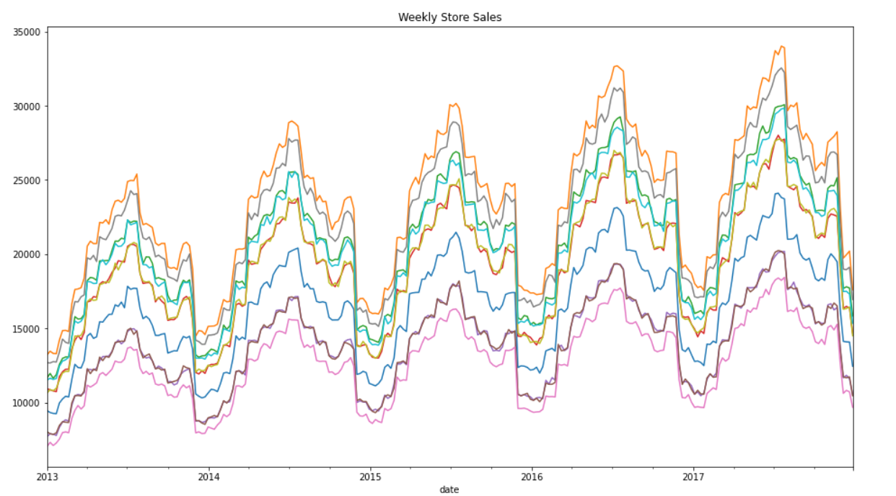
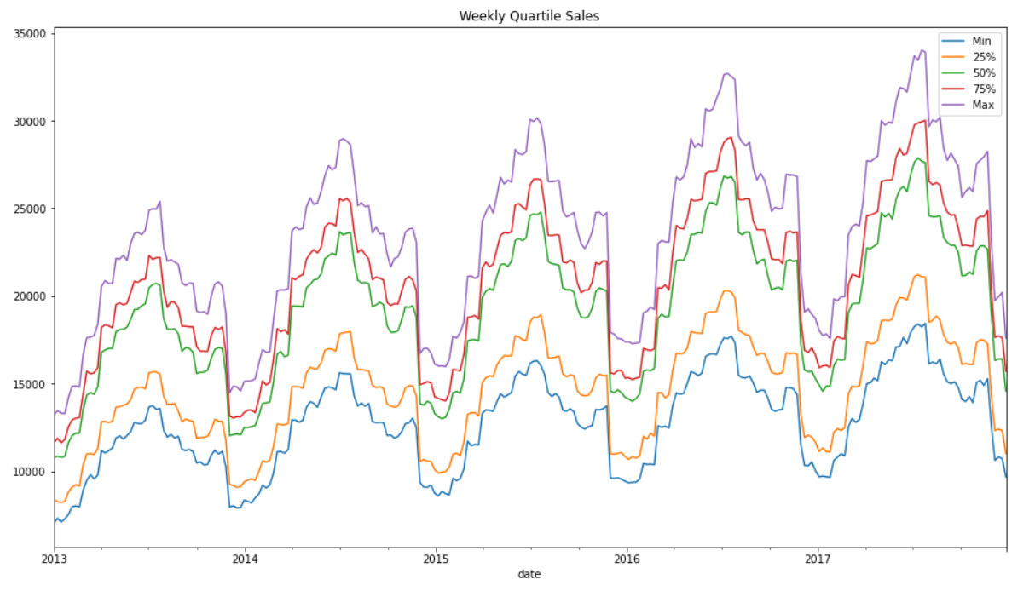
Weekly Store Sales and Quartile Sales

Slide 7
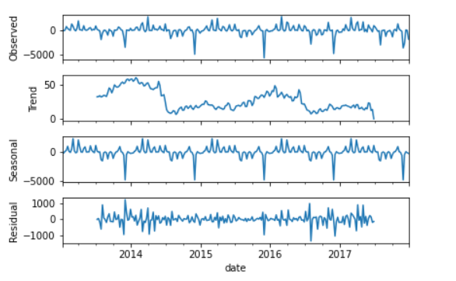
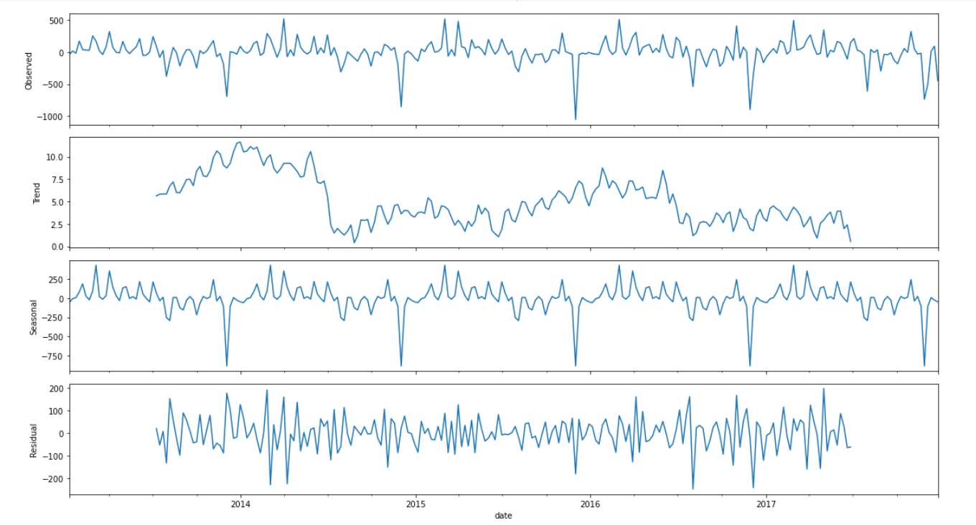
Store Wise Sales Seasonality
Item Wise Sales Seasonality

Slide 8
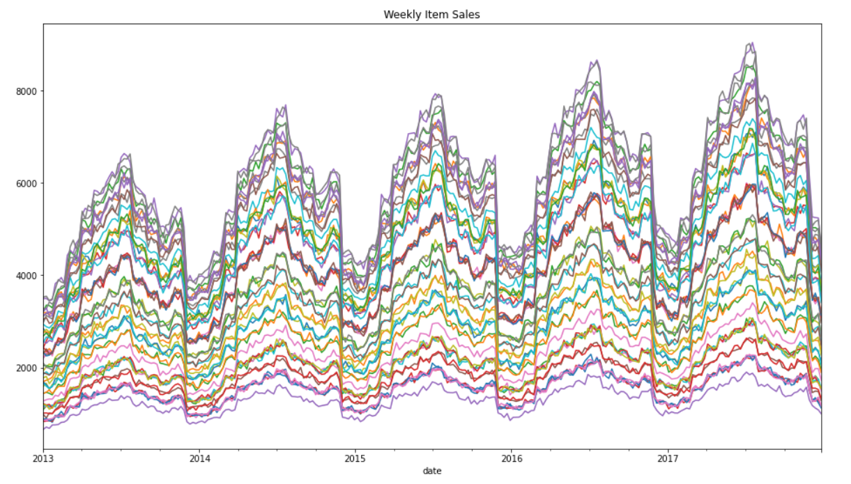
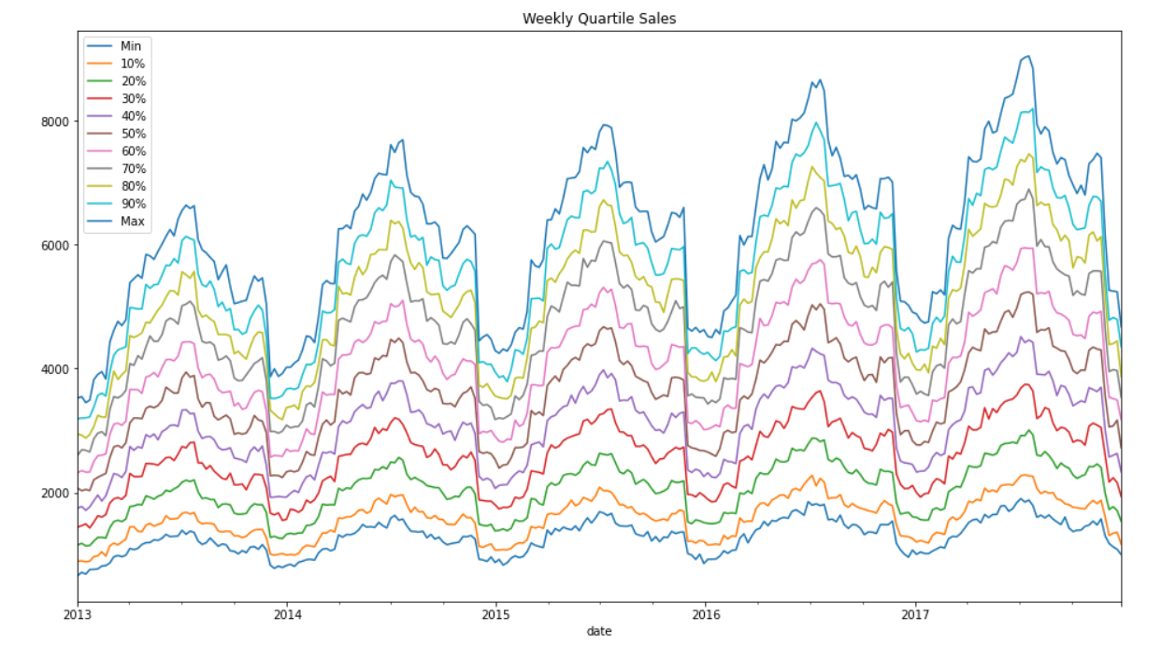
Weekly Item Sales
Weekly Quartile Sales

Slide 9
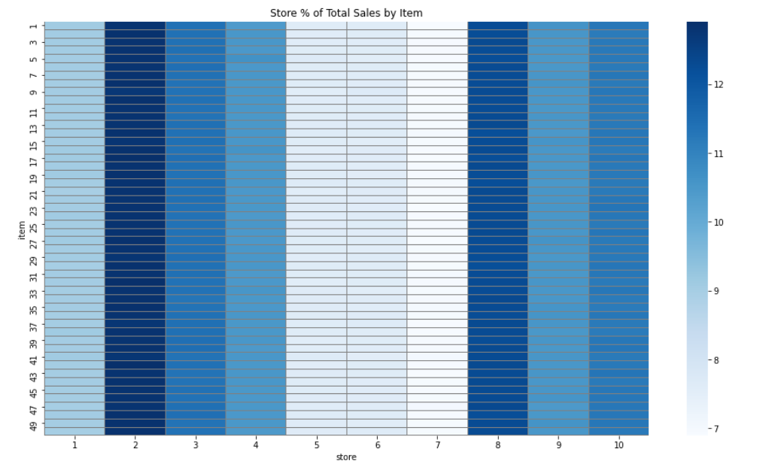
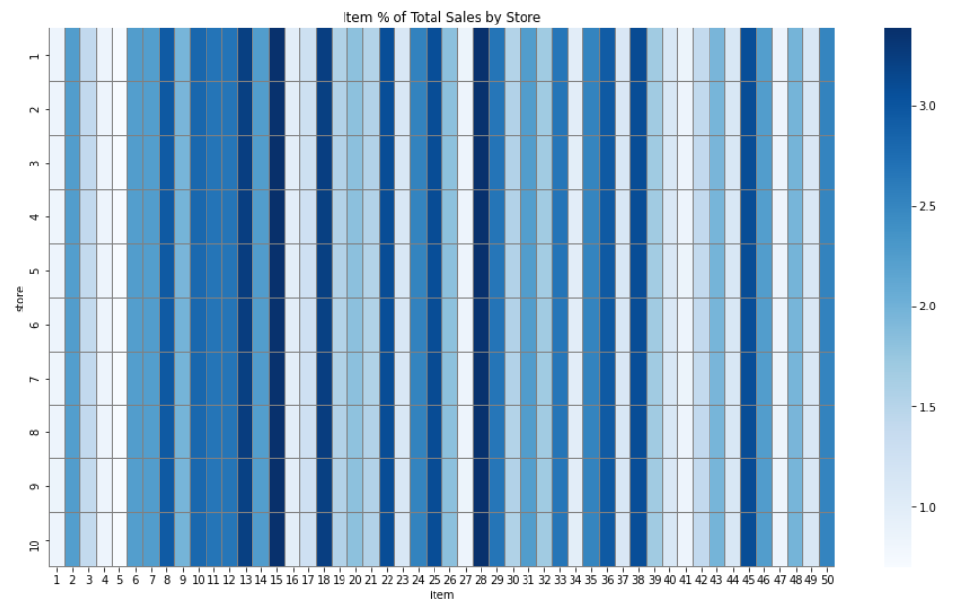
Total Sales by Item and Stores

Slide 10
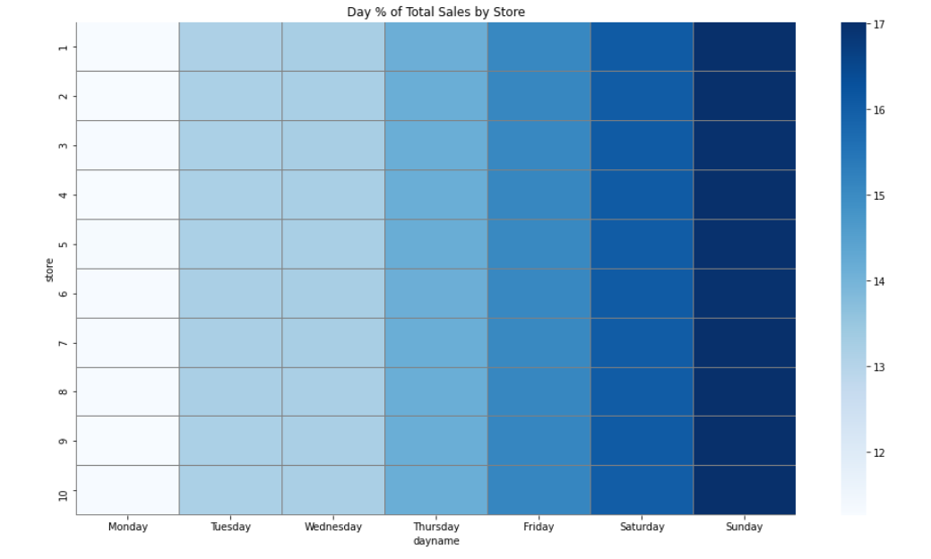
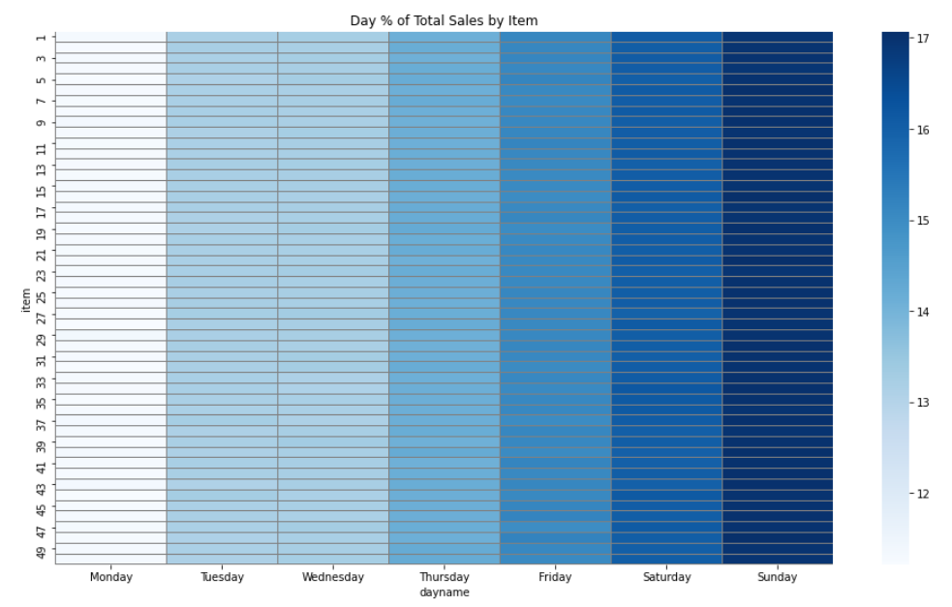
Daily total Sales by store and Items

Slide 11
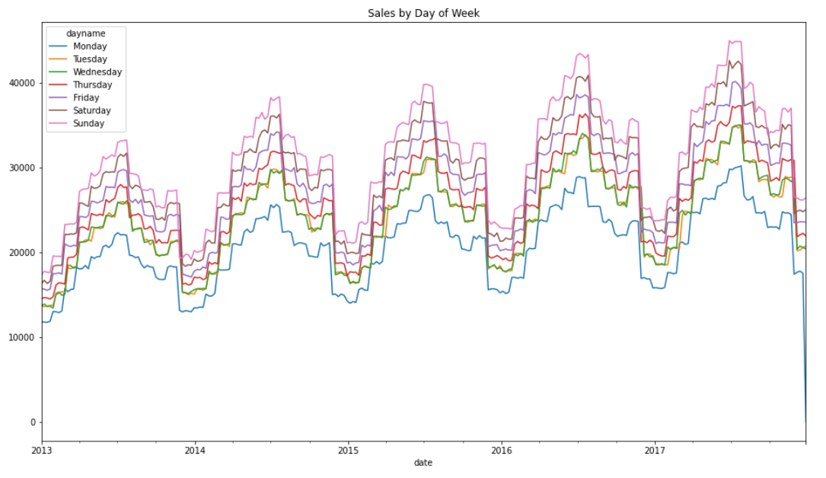
Sales by Day of Week

Slide 12
Methodology
Data was split into test data for the last 13 weeks ARIMA model was applied for forecasting and deviations between the actual vs forecast was compared using SMAPE (Symmetric Mean Absolute Percentage Error)
Sales Prediction
Used the ARIMA model to predict the 3 months sales
Model Predicted sales with an error of 23.03% using the SMAPE

Slide 13
Conclusion
ARIMA model can be used to predict the sales with an error tolerance of 23.03%
Other models can be tried example tensorflow’s DNN regressor and XG boosting for better accuracy

Slide 14
Best quote that reflects my approach… “It’s one small step for man, one giant leap for mankind.”
- Neil Armstrong
THANK YOU

